Slide 1


Slide 2

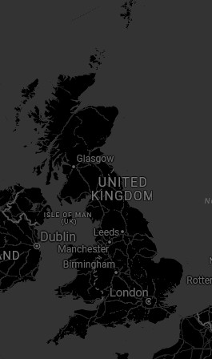



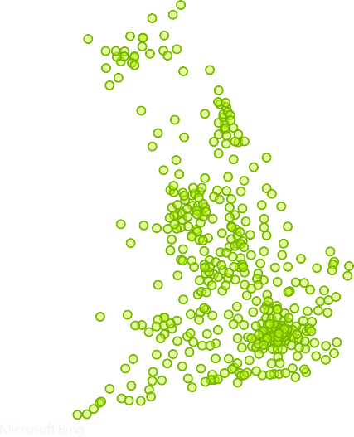



ROAD ACCIDENT ANALYSIS
Power BI Desktop
Road Surface V Weather_Conditions
V
All V
All V
Total CY Casualties
195.7K
-11.9%
Total CY Accidents
144.4K
-11.7%
CY Fatal Casualties
2.9K
-33.3%
CY Serious Casualties
27.0K
-16.2%
CY Slight Casualties
165.8K
-10.6%
Casualties by Vehicle Type
CY Casualties vs PY Casualties Monthly Trend
CY Casualties by Urban/Rural
Rural 38.05%
Casualties by Location
Agricultural
399
20K
2021
Bike
15610
2022
Bus
6573
10K
Jan Feb Mar Apr May Jun Jul Aug Sep Oct Nov Dec
Urban 61.95%
Car
155804
CY Casualties by Road_Type
Casualties by Light Condition
Single carriage…
145K
Dual carriagew…
32K
Dark 26.16%
Others
1446
Roundabout
One way street
Slip road
13K
3K
3K
Van
15905
Day
73.84%
0.0M
0.1M
©© 22002255 MMiiccrroossoofftt CCoorrppoorraattiioonn

Slide 3

Project Overview
In this project, we analyzed road accident data using Power BI and Python libraries like Matplotlib and Seaborn to deeply understand the key factors contributing to road accidents. The analysis was done for the years 2021 and 2022, with a focus on identifying high-risk conditions such as the type of vehicle involved, lighting conditions, weather factors, and accident-prone locations.
By transforming raw data into interactive visuals, we aimed to create an insightful and easy-to-understand dashboard that can help concerned authorities and stakeholders make data-driven decisions to reduce accidents and improve road safety.

Slide 4

Objective of the Project
The main objective of this project is to uncover hidden patterns and insights in road accident data and to identify the conditions and factors that lead to higher accident rates.
Specifically, we focused on:
Finding high-risk conditions (e.g., weather, light)
Identifying vehicle types and locations most prone to accidents
Comparing accident trends across time and area
Presenting all insights in a clear, interactive dashboard for better decision-making
The ultimate goal is to propose practical safety improvements and help authorities take preventive actions based on real evidence.

Slide 5

Tools & Technologies Used
To do this project, we used:
Power BI – to create interactive dashboards and visual charts
Python – to clean and analyze the data
Matplotlib & Seaborn – Python libraries used to make graphs and charts
Excel – to view and prepare the raw data
These tools helped us understand the accident data clearly and show the results in a simple, visual way.

Slide 6


Key Insights & Visualizations
In this section, we present the main findings from our data analysis. Each insight is shown through simple and meaningful visualizations created using Power BI and Python libraries (Matplotlib & Seaborn). These visuals helped us understand when, where, and how road accidents are happening the most.
1. Casualties by Vehicle Type
We analyzed which types of vehicles are most commonly involved in accidents that cause injuries or deaths.
Insight:
Most casualties happen in car accidents, contributing to nearly 80% of total cases.
Very few casualties were reported in accidents involving other vehicle types like agriculture vehicle or buses.
Purpose: To highlight which vehicle types need more safety awareness and monitoring.

Slide 7


2. Impact of Weather & Light Conditions
We studied how different weather conditions (dry, wet, icy, etc.) and lighting conditions (daylight, night, street lights) affect accidents.
Insight:
Around 73% of accidents happen in daylight, even more than at night.
Dry road surfaces had the highest number of casualties (about 67%), possibly because more people travel in good weather.
Purpose: Helps plan safety campaigns and road alerts depending on weather and time of day.
3. Monthly Trend Analysis
We looked at how accident numbers change month by month in 2021 and 2022.
Insight:
January and February had the highest number of casualties in both years.
November and December showed the lowest accident rates.
Purpose: Helps authorities focus more on critical months and prepare in advance.

Slide 8


4. Area-wise Casualties (Urban vs Rural)
This insight compares how many accidents happen in urban areas versus rural areas.
Insight:
About 61% of casualties occurred in urban areas.
This may be due to higher traffic density and more vehicle movement in cities.
Purpose: Suggests more strict traffic control and awareness in city areas.
5. Road Type-wise Analysis
We examined which types of roads have more accidents.
Insight:
The Single Carriageway roads had the maximum casualties (145K+).
Slip roads had the least number of casualties (just around 3K).
Purpose: Tells us where road improvements or upgrades (like converting to double carriageway) might reduce accidents.

Slide 9




Recommendations & Safety Improvements
Based on our data analysis and key insights, here are some practical steps and safety suggestions that can help reduce road accidents and make travel safer for everyone:
1. Focus on High-Risk Months
January and February saw the highest number of casualties.
👉 Action: Launch special road safety drives, increase traffic checks, and spread public awareness during these months to reduce accident risk.
2. Target Car Drivers for Awareness
Since cars are involved in nearly 80% of all casualties…
👉 Action: Organize defensive driving workshops, awareness campaigns, and strict enforcement of speed and seatbelt rules, especially for private vehicle owners.

Slide 10




3. Strengthen Safety in Urban Areas
61% of casualties happened in urban locations.
Action: Improve traffic signals, install more CCTV surveillance, and promote pedestrian safety zones in busy city areas.
  4. Upgrade Single Carriageway Roads
  Most accidents occurred on single carriageway roads.
  Action: Wherever possible, expand roads, add better lane markings, and install rumble strips or warning signs to reduce over speeding and lane-crossing.
5. Daytime Driving Needs Attention
Surprisingly, majority of accidents happen during daylight on dry roads.
Action: Even during normal conditions, ensure police patrolling, speed checks, and driver vigilance, especially in busy areas.

Slide 11


6. Improve Road Surface Conditions
Casualties on dry roads are still high, which may point to road design flaws or driver behavior.
Action: Regular maintenance of road surfaces, fixing potholes, and ensuring clear road markings can help reduce accidents.
7. Community Involvement & Education
Action: Conduct road safety workshops in schools, colleges, and workplaces to build a culture of responsible driving from a young age.

Slide 12
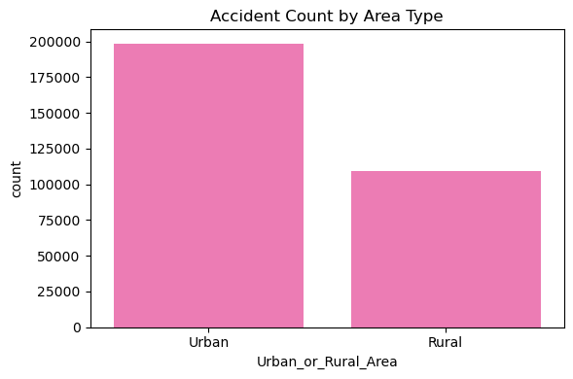
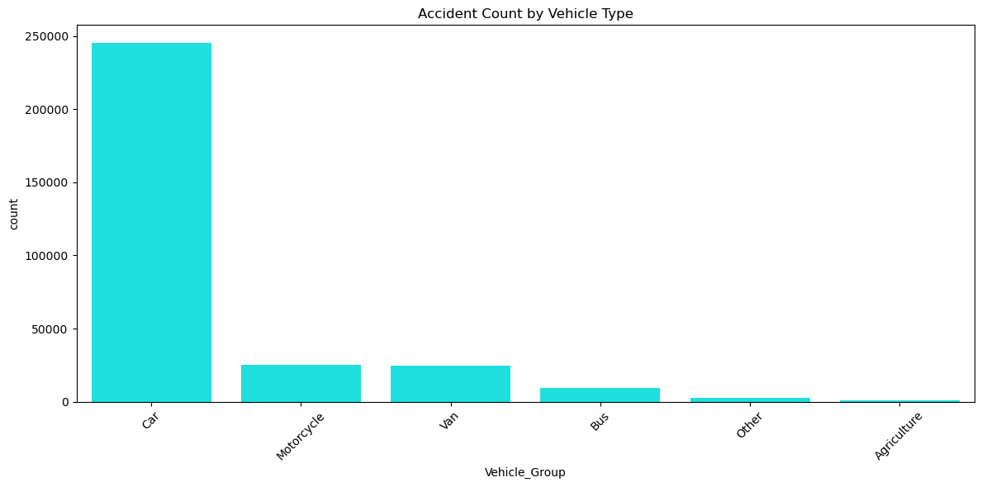
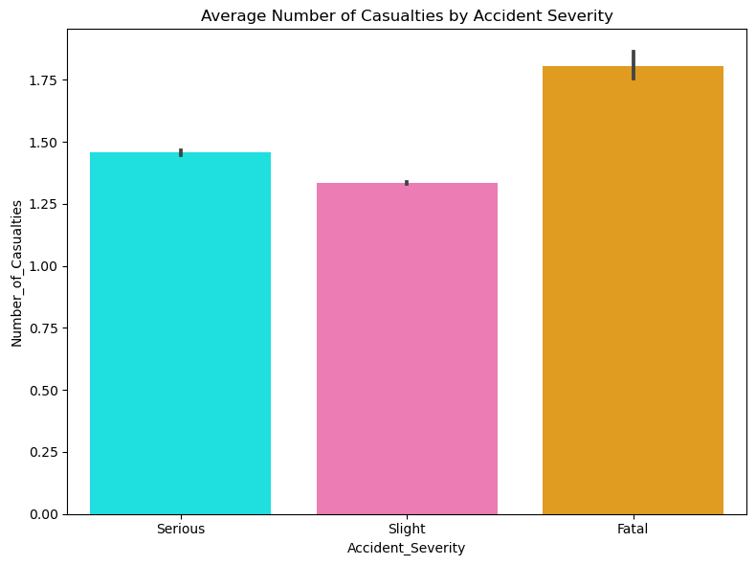
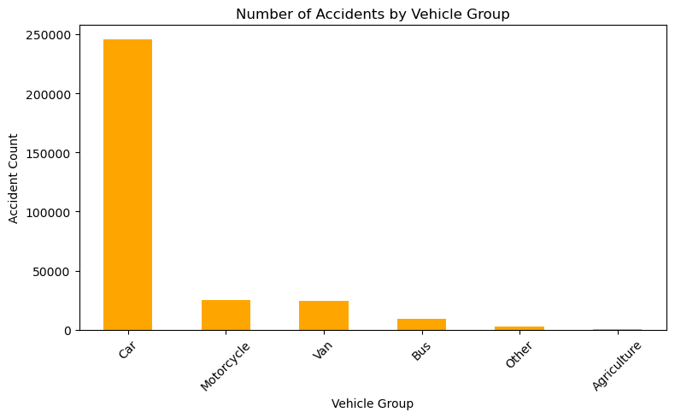
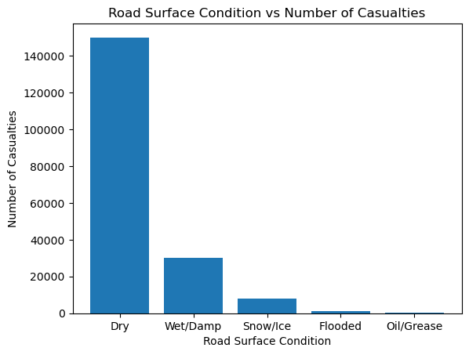
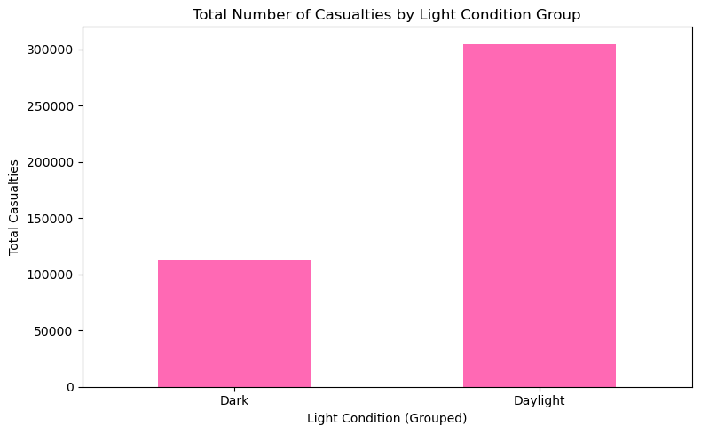

Slide 13

Thank You !
I appreciate your time and attention.
Feel free to connect or ask any questions.

